Slide 1
Descriptive Statistics
CADS MODULE 2 – SOCIAL JUSTICE 4330

Slide 2
Descriptive Statistics
Descriptive Statistics are Used by
Researchers to Report on Populations
and Samples
In Sociology:
Summary descriptions of measurements
(variables) taken about a group of
people
By Summarizing Information, Descriptive
Statistics Speed Up and Simplify
Comprehension of a Group’s
Characteristics

Slide 3
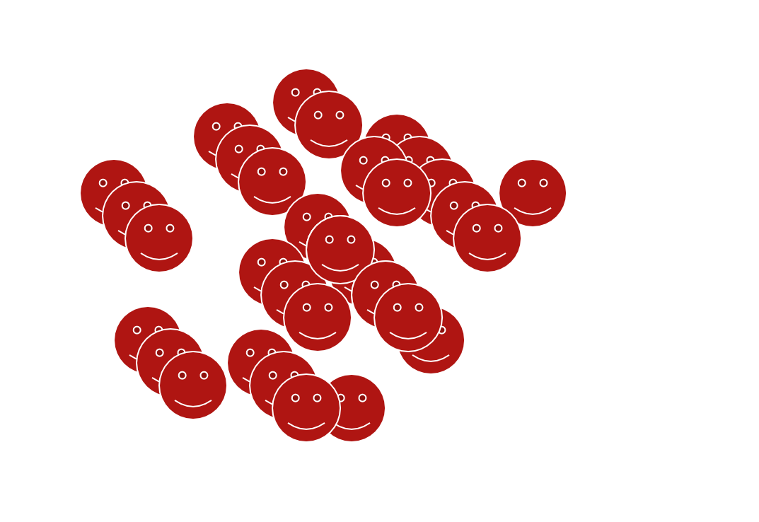
Sample vs. Population
Population
Sample

Slide 4
Descriptive Statistics
An Illustration:
Which Group is Smarter?
Class A--IQs of 13 Students Class B--IQs of 13 Students
102 | 115 | 127 | 162
128 | 109 | 131 | 103
131 | 89 | 96 | 111
98 | 106 | 80 | 109
140 | 119 | 93 | 87
93 | 97 | 120 | 105
110 |  | 109
Each individual may be different. If you try to understand a group by remembering the
qualities of each member, you become overwhelmed and fail to understand the group.

Slide 5
Descriptive Statistics
Which group is smarter now?
Class A--Average IQ
Class B--Average IQ
110.54
110.23
They’re roughly the same!
With a summary descriptive statistic, it is much easier to answer our question.

Slide 6
Descriptive Statistics
Types of descriptive statistics:
Organize Data
Tables
Graphs
Summarize Data
Central Tendency
Variation

Slide 7
Descriptive Statistics
Types of descriptive statistics:
Organize Data
Tables
Frequency Distributions
Relative Frequency Distributions
Graphs
Bar Chart or Histogram
Stem and Leaf Plot
Frequency Polygon

Slide 8
SPSS Output for Frequency Distribution
IQ
 |  | Frequency | Percent | Valid Percent | Cumulative Percent
Valid | 82.00 | 1 | 4.2 | 4.2 | 4.2
 | 87.00 | 1 | 4.2 | 4.2 | 8.3
 | 89.00 | 1 | 4.2 | 4.2 | 12.5
 | 93.00 | 2 | 8.3 | 8.3 | 20.8
 | 96.00 | 1 | 4.2 | 4.2 | 25.0
 | 97.00 | 1 | 4.2 | 4.2 | 29.2
 | 98.00 | 1 | 4.2 | 4.2 | 33.3
 | 102.00 | 1 | 4.2 | 4.2 | 37.5
 | 103.00 | 1 | 4.2 | 4.2 | 41.7
 | 105.00 | 1 | 4.2 | 4.2 | 45.8
 | 106.00 | 1 | 4.2 | 4.2 | 50.0
 | 107.00 | 1 | 4.2 | 4.2 | 54.2
 | 109.00 | 1 | 4.2 | 4.2 | 58.3
 | 111.00 | 1 | 4.2 | 4.2 | 62.5
 | 115.00 | 1 | 4.2 | 4.2 | 66.7
 | 119.00 | 1 | 4.2 | 4.2 | 70.8
 | 120.00 | 1 | 4.2 | 4.2 | 75.0
 | 127.00 | 1 | 4.2 | 4.2 | 79.2
 | 128.00 | 1 | 4.2 | 4.2 | 83.3
 | 131.00 | 2 | 8.3 | 8.3 | 91.7
 | 140.00 | 1 | 4.2 | 4.2 | 95.8
 | 162.00 | 1 | 4.2 | 4.2 | 100.0
 | Total | 24 | 100.0 | 100.0

Slide 9
Frequency Distribution
Frequency Distribution of IQ for Two Classes
IQ | Frequency
82.00 | 1
87.00 | 1
89.00 | 1
93.00 | 2
96.00 | 1
97.00 | 1
98.00 | 1
102.00 | 1
103.00 | 1
105.00 | 1
106.00 | 1
107.00 | 1
109.00 | 1
111.00 | 1
115.00 | 1
119.00 | 1
120.00 | 1
127.00 | 1
128.00 | 1
131.00 | 2
140.00 | 1
162.00 | 1
Total | 24

Slide 10
Grouped Relative Frequency Distribution
Relative Frequency Distribution of IQ for Two Classes
IQ | Frequency | Percent | Cumulative Percent
80 – 89 | 3 | 12.5 | 12.5
90 – 99 | 5 | 20.8 | 33.3
100 – 109 | 6 | 25.0 | 58.3
110 – 119 | 3 | 12.5 | 70.8
120 – 129 | 3 | 12.5 | 83.3
130 – 139 | 2 | 8.3 | 91.6
140 – 149 | 1 | 4.2 | 95.8
150 and over | 1 | 4.2 | 100.0
Total | 24 | 100.0 | 100.0

Slide 11
SPSS Output for Histogram
6
5
4
Frequency
3
2
1
Mean = 110.4583 Std. Dev. = 19.00338 N = 24
0
80.00
100.00
120.00
IQ
140.00
160.00

Slide 12
Histogram
Histogram of IQ Scores for Two Classes
6
5
4
Frequency
3
2
1
0
80.00
100.00
120.00
IQ
140.00
160.00

Slide 13
Bar Graph
Bar Graph of Number of Students in Two Classes
12
10
8
Count
6
4
2
0
1.00
2.00
Class

Slide 14
Stem and Leaf Plot
Stem and Leaf Plot of IQ for Two Classes
Stem Leaf
8
9
10
11
12
13
14
15
16
2 7 9
3 6 7 8
2 3 5 6 7 9
1 5 9
0 7 8
1
0
2
Note: SPSS does not do a good job of producing these.

Slide 15
SPSS Output of a Frequency Polygon
2.0
1.8
1.6
1.4
1.2
1.0
82.00 89.00 96.00 98.00 103.00 106.00 109.00 115.00 120.00 128.00 140.00
87.00 93.00 97.00 102.00 105.00 107.00 111.00 119.00 127.00 131.00 162.00
IQ
Count

Slide 16
Descriptive Statistics
Summarizing Data:
Central Tendency (or Groups’ “Middle
Values”)
Mean
Median
Mode
Variation (or Summary of Differences Within
Groups)
Range
Interquartile Range
Variance
Standard Deviation

Slide 17
Mean
Most commonly called the “average.”
Add up the values for each case and divide by the total number of cases.
Y-bar =
(Y1 + Y2 + . . . + Yn)
n
Y-bar = Σ Yi
n

Slide 18
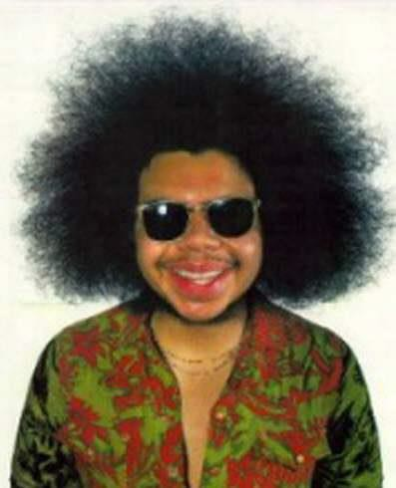
Mean
What’s up with all those symbols, man?
Y-bar = (Y1 + Y2 + . . . + Yn)
n
Y-bar = Σ Yi
n
Some Symbolic Conventions in this Class:
Y = your variable (could be X or Q or ☺ or even “Glitter”)
“-bar” or line over symbol of your variable = mean of that variable
Y1 = first case’s value on variable Y
“. . .” = ellipsis = continue sequentially
Yn = last case’s value on variable Y
n = number of cases in your sample
Σ = Greek letter “sigma” = sum or add up what follows
i = a typical case or each case in the sample (1 through n)

Slide 19
Mean
Class A--IQs of 13 Students
Class B--IQs of 13 | Students
127 | 162
131 | 103
96 | 111
80 | 109
93 | 87
120 | 105
109
102 | 115
128 | 109
131 | 89
98 | 106
140 | 119
93 | 97
110 Σ Yi = 1437
Σ Yi = 1433
Y-bar_{A} =
Σ Yi = 1437 = 110.54
n 13
Y-bar_{B} = Σ Yi = 1433 = 110.23
n 13

Slide 20
Mean
The mean is the “balance point.”
Each person’s score is like 1 pound placed at the score’s position on a see-saw. Below, on a 200 cm see-saw, the mean equals 110, the place on the see-saw where a fulcrum finds balance:
1 lb at
93 cm
1 lb at
106 cm
1 lb at
131 cm
110 cm
17
units
below
21
units
above
4
units
below
0
units
The scale is balanced because…
17 + 4 on the left =
21 on the right

Slide 21
Mean
Means can be badly affected by outliers (data points with extreme values unlike the rest)
Outliers can make the mean a bad measure of central tendency or common experience
Income in the U.S.
Bill Gates Outlier
All of Us
Mean

Slide 22
Median
The middle value when a variable’s values are ranked in order; the point that divides a distribution into two equal halves.
When data are listed in order, the median is the point at which 50% of the cases are above and 50% below it.
The 50th percentile.

Slide 23
Median
Class A--IQs of 13 Students
89
93
97
98
102
106
109
Median = 109
(six cases above, six below)
110
115
119
128
131
140

Slide 24
Median
If the first student were to drop out of Class A, there
would be a new median:
89
93
97
98
102
106
109
110
Median = 109.5
109 + 110 = 219/2 = 109.5
(six cases above, six below)
115
119
128
131
140

Slide 25
Median
1. The median is unaffected by outliers, making it a better measure of central tendency, better describing the “typical person” than the mean when data are skewed.
Bill Gates
outlier
All of Us

Slide 26
Median
If the recorded values for a variable form a symmetric distribution, the median and mean are identical.
In skewed data, the mean lies further toward the skew than the median.
Symmetric
Skewed
Mean
Mean
Median
Median

Slide 27
Median
The middle score or measurement in a set
of ranked scores or measurements; the
point that divides a distribution into two
equal halves.
Data are listed in order—the median is the
point at which 50% of the cases are
above and 50% below.
The 50th percentile.

Slide 28
Mode
The most common data point is called the mode.
The combined IQ scores for Classes A & B:
80 87 89 93 93 96 97 98 102 103 105 106 109 109 109 110 111 115 119 120
127 128 131 131 140 162
A la mode!!
BTW, It is possible to have more than one mode!

Slide 29
Mode
It may mot be at the center of a distribution.
2.0
1.8
1.6
1.4
1.2
1.0
82.00 89.00 96.00 98.00 103.00 106.00 109.00 115.00 120.00 128.00 140.00
87.00 93.00 97.00 102.00 105.00 107.00 111.00 119.00 127.00 131.00 162.00
IQ
Data distribution on the right is “bimodal” (even statistics can be open-minded)
Count

Slide 30
Mode
It may give you the most likely experience rather
than the “typical” or “central” experience.
In symmetric distributions, the mean, median, and
mode are the same.
In skewed data, the mean and median lie further toward the skew than the mode.
Symmetric
Skewed
Mean
Median
Mode
Mode
Median
Mean

Slide 31
Descriptive Statistics
Summarizing Data:
Central Tendency (or Groups’ “Middle
Values”)
Mean
Median
Mode
Variation (or Summary of Differences Within
Groups)
Range
Interquartile Range
Variance
Standard Deviation

Slide 32
Range
The spread, or the distance, between the lowest and
highest values of a variable.
To get the range for a variable, you subtract its lowest value from its highest value.
Class A--IQs of 13 Students
Class B--IQs of 13 Students
102 | 115
128 | 109
131 | 89
98 | 106
140 | 119
93 | 97
110
127 | 162
131 | 103
96 | 111
80 | 109
93 | 87
120 | 105
109
Class A Range = 140 - 89 = 51
Class B Range = 162 - 80 = 82

Slide 33
Interquartile Range
A quartile is the value that marks one of the divisions that breaks a series of values into four equal parts.
The median is a quartile and divides the cases in half.
25th percentile is a quartile that divides the first ¼ of cases from the latter ¾. 75th percentile is a quartile that divides the first ¾ of cases from the latter ¼.
The interquartile range is the distance or range between the 25th percentile and the 75th percentile. Below, what is the interquartile range?
25% 25%
25%
of cases
25%
of cases
0
250
500
750
1000

Slide 34
Variance
A measure of the spread of the recorded values on a variable. A
measure of dispersion.
The larger the variance, the further the individual cases are from the mean.
Mean
The smaller the variance, the closer the individual scores are to the
mean.
Mean

Slide 35
Variance
Variance is a number that at first seems complex to calculate.
Calculating variance starts with a “deviation.”
A deviation is the distance away from the mean of a
case’s score.
If the average person’s car costs $20,000, my deviation from the mean is - $14,000!
6K - 20K = -14K
Yi – Y-bar

Slide 36
Variance
The deviation of 102 from 110.54 is?
Deviation of 115?
Class A--IQs of 13 Students
102 |  | 115
128 |  | 109
131 |  | 89
98 |  | 106
140 |  | 119
93 |  | 97
110 Y-bar_{A} | = 110.54

Slide 37
Variance
The last step…
The approximate average sum of squares is the variance.
SS/N = Variance for a population.
SS/n-1 = Variance for a sample. Variance = Σ(Yi – Y-bar)² / n – 1

Slide 38

Variance
For Class A, Variance = 2825.39 / n - 1
= 2825.39 / 12 = 235.45
How helpful is that???

Slide 39
Standard Deviation
To convert variance into something of meaning,
let’s create standard deviation.
The square root of the variance reveals the average deviation of the observations from the mean.
s.d. =
Σ(Yi – Y-bar)² n - 1

Slide 40
Standard Deviation
For Class A, the standard deviation is:
235.45 = 15.34
The average of persons’ deviation from the mean IQ of
110.54 is 15.34 IQ points.
Review:
Deviation
Deviation squared
Sum of squares
Variance
Standard deviation

Slide 41
Standard Deviation
1. Larger s.d. = greater amounts of variation around the mean.
For example:
19
25 31
Y = 25
s.d. = 3
13
25
Y = 25
s.d. = 6
37
s.d. = 0 only when all values are the same (only when you have a
constant and not a “variable”)
If you were to “rescale” a variable, the s.d. would change by the same magnitude—if we changed units above so the mean equaled 250, the s.d. on the left would be 30, and on the right, 60
Like the mean, the s.d. will be inflated by an outlier case value.

Slide 42
Standard Deviation
Note about computational formulas:
Your book provides a useful short-cut formula for
computing the variance and standard deviation.
This is intended to make hand calculations as quick as possible.
They obscure the conceptual understanding of our
statistics.
SPSS and the computer are “computational formulas” now.

Slide 43
Practical Application for Understanding Variance and Standard Deviation
Even though we live in a world where we pay real dollars for goods and services (not percentages of income), most American employers issue raises based on percent of salary.
Why do supervisors think the most fair raise is a percentage raise? Answer: 1) Because higher paid persons win the most money.
2) The easiest thing to do is raise everyone’s salary by a
fixed percent.
If your budget went up by 5%, salaries can go up by 5%.
The problem is that the flat percent raise gives unequal increased rewards. . .

Slide 44
Practical Application for Understanding Variance and Standard Deviation
Acme Toilet Cleaning Services
Salary Pool: $200,000
Incomes:
President: $100K; Manager: 50K; Secretary: 40K; and Toilet Cleaner: 10K
Mean: $50K Range: $90K
Variance: $1,050,000,000
Standard Deviation: $32.4K
These can be considered “measures of inequality”
Now, let’s apply a 5% raise.

Slide 45

Practical Application for Understanding Variance and Standard Deviation
Toilet Cleaner Secretary Manager President
The gap between the rich and poor expands.
This is why some progressive organizations give a percentage raise with a flat increase for lowest wage earners. For example, 5% or
$1,000, whichever is greater.

Slide 46
Descriptive Statistics
Summarizing Data:
Central Tendency (or Groups’ “Middle Values”)
Mean
Median
Mode
Variation (or Summary of Differences Within Groups)
Range
Interquartile Range
Variance
Standard Deviation
…Wait! There’s more

Slide 47
Box-Plots
A way to graphically portray almost all the descriptive statistics at once is the box-plot.
A box-plot shows: Upper and lower quartiles
Mean
Median
Range
Outliers (1.5 IQR)

Slide 48
Box-Plots
180.00
IQR = 27; There
is no outlier.
160.00
162
140.00
120.00
123.5
106.5
M=110.5
96.5
100.00
82
80.00
IQ

Slide 49
IQV—Index of Qualitative Variation
For nominal variables
Statistic for determining the dispersion of cases
across categories of a variable.
Ranges from 0 (no dispersion or variety) to 1 (maximum dispersion or variety)
1 refers to even numbers of cases in all categories, NOT that cases are distributed like population proportions
IQV is affected by the number of categories

Slide 50
IQV—Index of Qualitative Variation
To calculate:
K(100² – Σ cat.%²) IQV = 100²(K – 1)
K=# of categories
Cat.% = percentage in each category

Slide 51
IQV—Index of Qualitative Variation
Problem: Is SJSU more diverse than UC Berkeley?
Solution: Calculate IQV for each campus to determine which is higher.
SJSU: |  |  | UC Berkeley:
Percent |  | Category | Percent Category
00.6 | Native American |  | 00.6 | Native American
06.1 | Black |  | 03.9 | Black
39.3 | Asian/PI |  | 47.0 | Asian/PI
19.5 | Latino |  | 13.0 | Latino
34.5 | White |  | 35.5 | White
What can we say before calculating? Which campus is more evenly distributed?
K (100² – Σ cat.%²)
IQV =
100²(K – 1)

Slide 52

Descriptive Statistics
Now you are qualified use descriptive statistics!
Questions?

